Slide 1
Phase 1 Project assignment
Exploratory Data Analysis

Slide 2
Introduction
Microsoft Corporation is an American multinational technology corporation producing computer software, consumer electronics, personal computers, and related services.
Microsoft's best-known software products are the Windows line of operating systems, the Microsoft Office suite, and the Internet Explorer and Edge web browsers.

Slide 3

Project Objective
To be able to create a list of films that are doing better at the box office

Slide 4
Exploratory Data Analysis

Slide 5
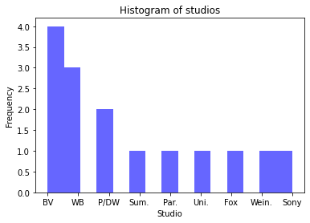
Visualization of the top ten studio by the domestic gross income
BV and WB studios are top two studios that is vested in the dataset

Slide 6
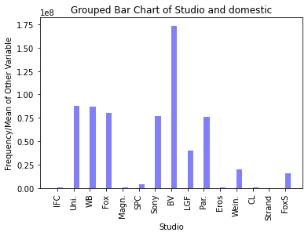
Top ten studios by domestic gross income
BV is the best domestic gross performing studios

Slide 7
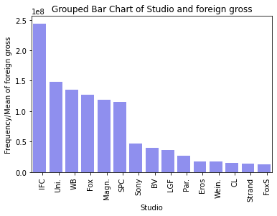
Top ten studios by foreign gross income
IFC is the best foreign gross performing studios

Slide 8
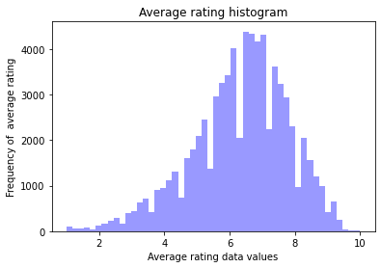
Overall rating score
A score of 7 is the average rating for the most studios as depicted by the data.

Slide 9
Average runtime in minutes
 | start_year | runtime_minutes
count | 146144.000000 | 114405.000000
mean | 2014.621798 | 86.187247
std | 2.733583 | 166.360590
min | 2010.000000 | 1.000000
25% | 2012.000000 | 70.000000
50% | 2015.000000 | 87.000000
75% | 2017.000000 | 99.000000
max | 2115.000000 | 51420.000000

Slide 10
Recommendations
Microsoft should consider investing in BV and Wb studios as they are the top two selling studios
To invest domestically, they should put more focus on the BV studios
To acquire more market spaces, they should aim a rating of between 6-8 scores as the average rating is approximately 7

